Slide 1

Electrical circuits and electronics

Slide 2
Content
What is electricity?
Atoms and electrons
Current, voltage, resistance
Electric circuits and schematic diagrams
Ohm's law
Resistors, capacitors and inductors
Binary
Floating point numbers

Slide 3
Electricity
What is electricity?
https://courses.edx.org/courses/course-v1:CurtinX+IOT2x+2T2018/jump_to/block-v1:CurtinX+IOT2x+2T2018+type@vertical+block@cd001f02729b4b24b44764699fae9ff0

Slide 4
Note
Energy is the generic name we give to everything that can produce work.
Electricity is a form of energy.

Slide 5
Electricity
Atoms and electrons?
https://courses.edx.org/courses/course-v1:CurtinX+IOT2x+2T2018/jump_to/block-v1:CurtinX+IOT2x+2T2018+type@vertical+block@94bf8a66a177436daaf4ea6e39369b53

Slide 6
Note
All elements are made up of atoms.
Atoms have a nucleus which contains positively charged protons and neutrally charged neutrons, usually the same amount of each.
Electricity occurs when the negatively charged electrons jump between atoms.

Slide 7
Electricity
Current, voltage, resistance
https://courses.edx.org/courses/course-v1:CurtinX+IOT2x+2T2018/jump_to/block-v1:CurtinX+IOT2x+2T2018+type@vertical+block@ecf76d5f9cbd4fcf90858612d2e6656b

Slide 8
Note
Electric current
The flow of electrons jumping between atoms from a negatively charged to a positively charged point is called electric current (I).
Voltage
The difference in electric charge between two points is called voltage (V).
Resistance
Since all materials are made out of atoms, all of them have electrical properties. One important property is the ability to conduct electricity. This property is called resistance (R).
Resistors
In electrical circuits, resistance is often provided by resistors.

Slide 9
Electricity
Electric circuits and schematic diagrams
https://courses.edx.org/courses/course-v1:CurtinX+IOT2x+2T2018/jump_to/block-v1:CurtinX+IOT2x+2T2018+type@vertical+block@2d978578471947bcb5aa6e5124d121d4

Slide 10
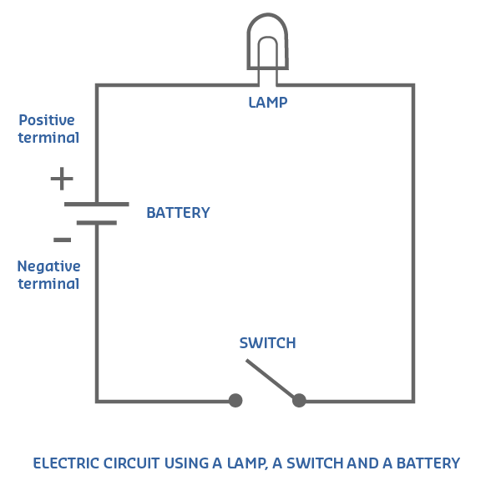
Note
A schematic diagram is a graphical representation of an electrical circuit.
A schematic diagram shows the components and interconnections of the circuit using standardized symbolic representations.
The presentation of the interconnections between circuit components in the schematic diagram does not necessarily correspond to the physical arrangements in the finished device.

Slide 11
Electricity
Ohm's law
https://courses.edx.org/courses/course-v1:CurtinX+IOT2x+2T2018/jump_to/block-v1:CurtinX+IOT2x+2T2018+type@vertical+block@be9f2509495b46da907a4dd958854c77

Slide 12
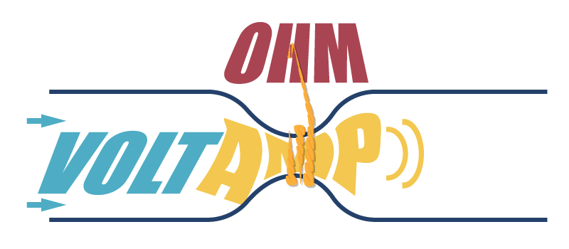
Note
I = V/R

Slide 13
Electricity
Resistors, capacitors and inductors
https://courses.edx.org/courses/course-v1:CurtinX+IOT2x+2T2018/jump_to/block-v1:CurtinX+IOT2x+2T2018+type@vertical+block@7163983bbba5411d9f42c473d0aad809

Slide 14
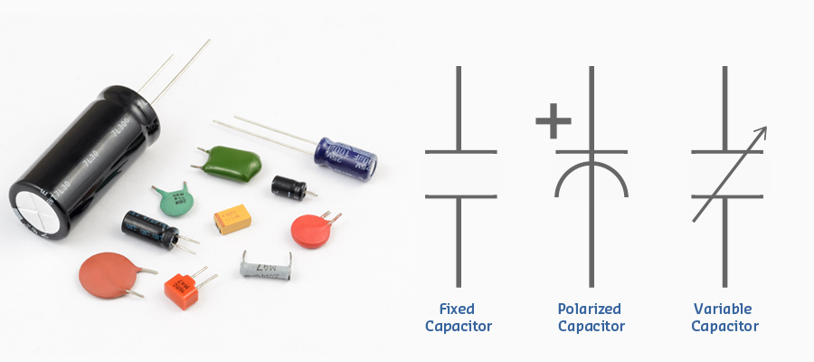
Electricity
Resistors are called passive components because they do not need an external power supply to show their electric properties, nor do they produce any power.
Other passive components are: Capacitors and Inductors

Slide 15
Digital electronics
Binary
https://courses.edx.org/courses/course-v1:CurtinX+IOT2x+2T2018/jump_to/block-v1:CurtinX+IOT2x+2T2018+type@vertical+block@db7a79cde3d848e19ca52b1ff5e04de7
https://courses.edx.org/courses/course-v1:CurtinX+IOT2x+2T2018/jump_to/block-v1:CurtinX+IOT2x+2T2018+type@vertical+block@a1bce2d2485b407d85d9b962e7bdc1ca

Slide 16
Note
There are a number of conditions in real life that can be described with only two states, for example:
Yes/No
In/Out
Present/Not present
Conditions like this are called binary, and the unit used to describe binary variables is the bit. One transistor can represent one bit of binary information. One bit can represent only two numeric values: 0 and 1.

Slide 17
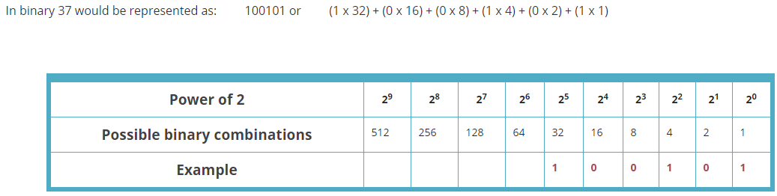
Note

